Slide 1
Methods for Cutpoint Determination
Carter W. Daniels, PhD
Advisor – Statistics & Modeling
Eli Lilly & Co

Slide 2
Outline
About me
What is a cutpoint analysis
Cutpoints for ADAs in gene therapy
Typical workflow with outlier analysis
Typical approach for cutpoint determination (Davanarayn et al. 2017)
Extreme Value Theory approach for cutpoint determination (Pugh et al. 2024)
Bayesian Approach (LeBlond et al. 2022)
Results comparing typical, EVT, and Bayesian approach
A mixture model proposal for ADA capsid responses
Conclusions

Slide 3




About Me
University of Kentucky (BA)
Foundation skills: Animal Behavior & Experimental Design
Lilly/Prevail Papers:
Sevigny et al. (2023) GRN gene therapy
Ahuja et al. (In prep) Comparability of two gene therapy CMC processes
Arizona State University (MA, PhD)
Foundation skills: Statistics/Computational Modeling & Neuroscience
ASU Modeling Papers:
1. Daniels & Sanabria (2017): Concatenated Static & Dynamic Mixture Models
2. Daniels & Sanabria (2018): Reinforcement-learning explains gambling
3. Daniels et al., (2018) Bayesian Dynamic Mixture Models
Columbia University & Barnard College Post-doc
Foundation skills:
Statistics & Behavioral Pharmacology
Columbia Modeling Papers:
Daniels & Balsam (2023) Reinforcement learning model of auditory signal detection
Thrailkill & Daniels (2024) Mixture models of habit structure
Jiminez et al. (submitted) Bayesian Behavioral Economics
Eli Lilly/Prevail
Foundational Skills: Combing skill sets to help drive forward gene therapy drug development for neurodegenerative disorders
Stats Courses
ANOVA & Experimental Design
Regression Modeling
Linear & non-linear mixed-effects modeling’
Bayesian statistics
-In general, trained with the mathematical psychologist Federico Sanabria, PhD
Disease progression models
Bioassay qualification, development, bridging, comparability, cutpoints
Omics datasets
FDA submissions (pre-IND, INDs, IND amendments)

Slide 4
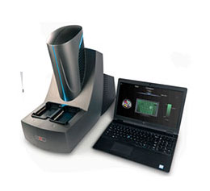
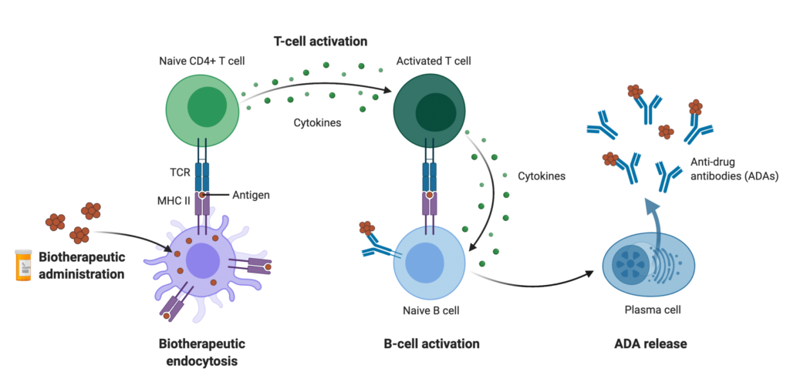

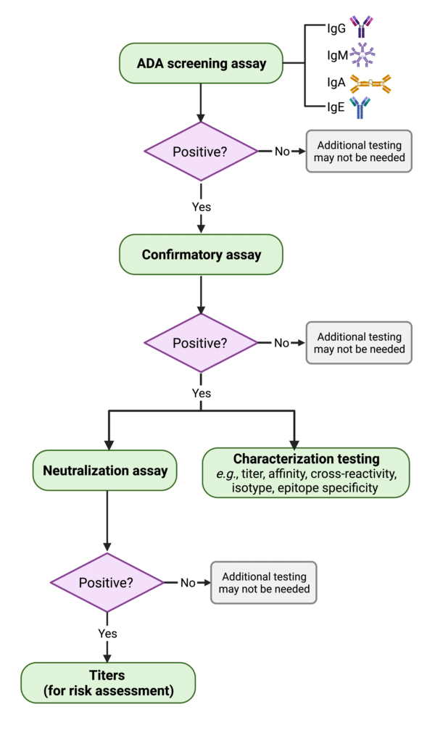
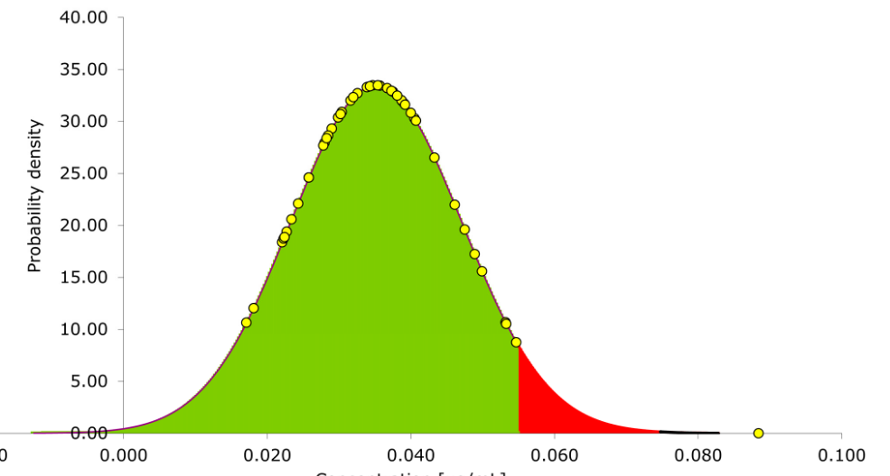
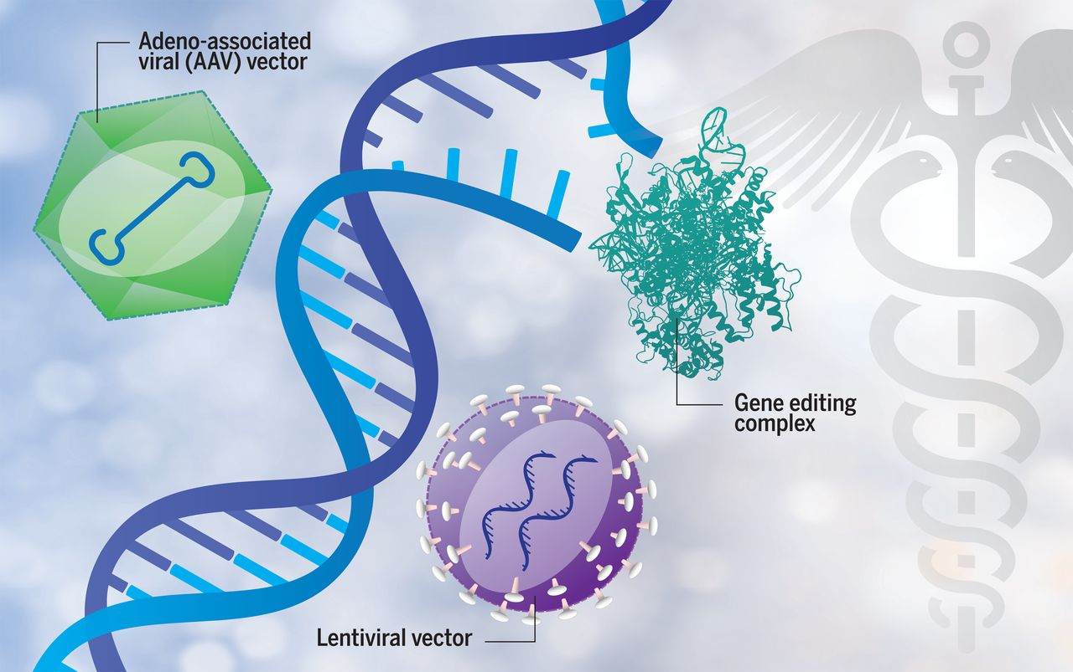
What is a cutpoint analysis?
A cutpoint is the threshold ($θ$) at which we categorize something moving from a negative (-) to a positive (+) result.
Cutpoints can be deployed in many different situations including whether an individual has anti-drug antibodies (ADAs).
Sample from population of drug-naive individuals
Prep samples, conduct assay
Wang & Gerpe, 2021; Rapid Novor
Conor Gearin, 2016; NewScientist
Mercodia
Conduct cutpoint analysis which results in…
Wang & Gerpe, 2021; Rapid Novor
Smeijsters et al. 2023
Dunbar et al. 2018

Slide 5
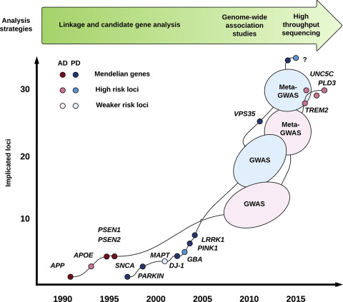
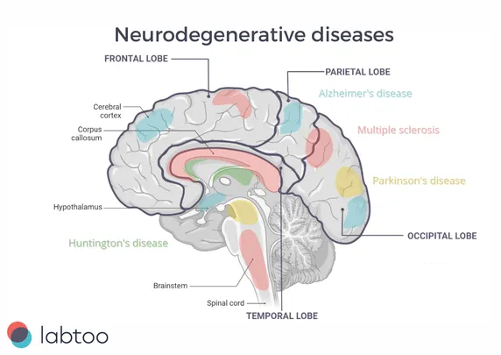
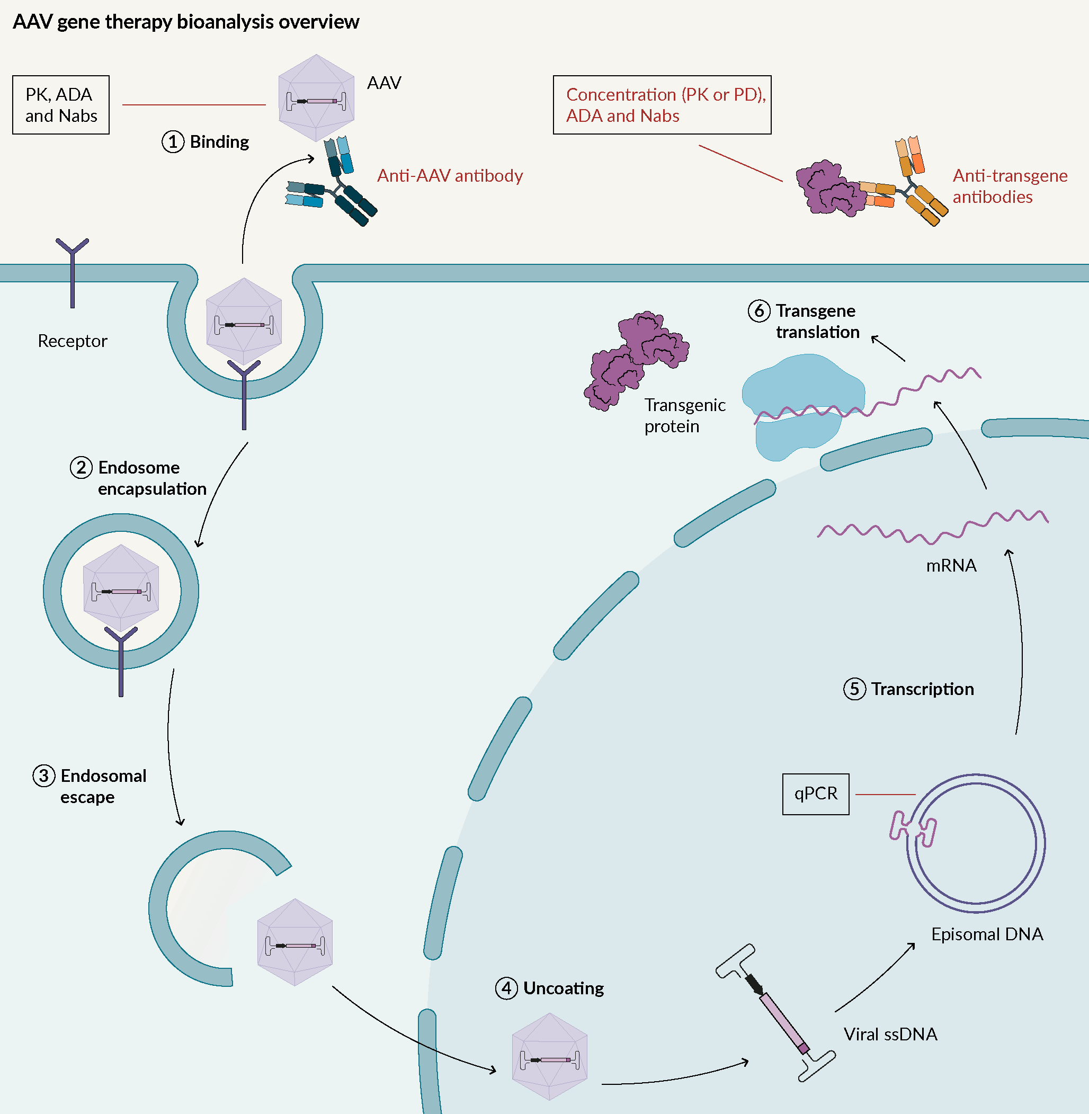
Cutpoint analyses for gene therapy products
Jyamubandi (2023)
Philstrom et al. 2018
ADAs need to be measured for gene therapy products across different components of the product:
capsid, transgene, transprotein
Here I will (1) describe the general cutpoint method, (2) compare alternatives, and (3) building off an alternative, of propose an option for what to do when we anticipate ADAs in drug-naïve individuals (e.g., in response to AAV9 capsids)
Situation/Task: Lilly/Prevail asked me to help statistically define cutpoints for a transprotein ADA assay developed for an NHP-GLP study.

Slide 6

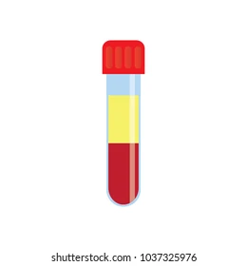
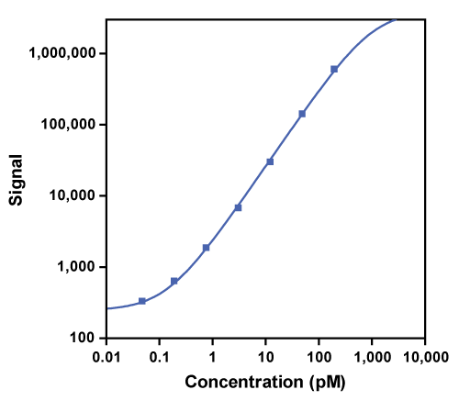
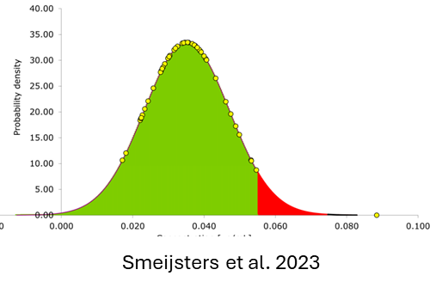
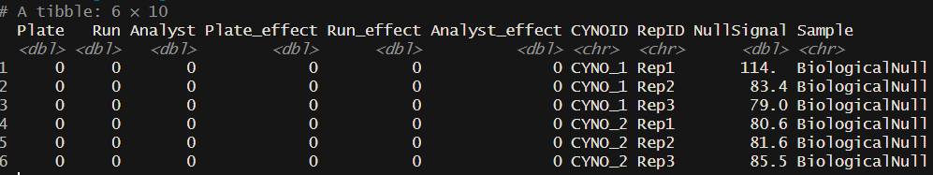
Cutpoint Workflow
30 Naïve NHP NC Samples
30 Naïve NHP Experimental Samples
Experimental Samples
NC, LPC, and HPC
Run in triplicate
Used to create a negative control pool
Screening samples: no drug
Confirmatory samples: ~ LLOQ drug
2 plates/run/analyst
2 runs
2 analyst
Standard Curve to interpolate Concentration of Total ADA
Format Data for Analysis
Begin Analysis
All data in this ppt was simulated on my home computer. You can regenerate this work with the code stored on my Github: https://github.com/drcwadaniels/DefiningCutPoints

Slide 7
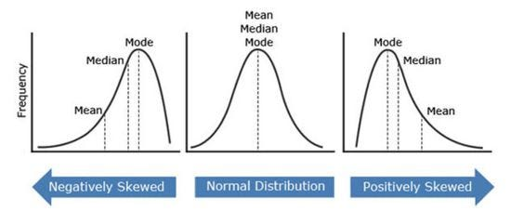
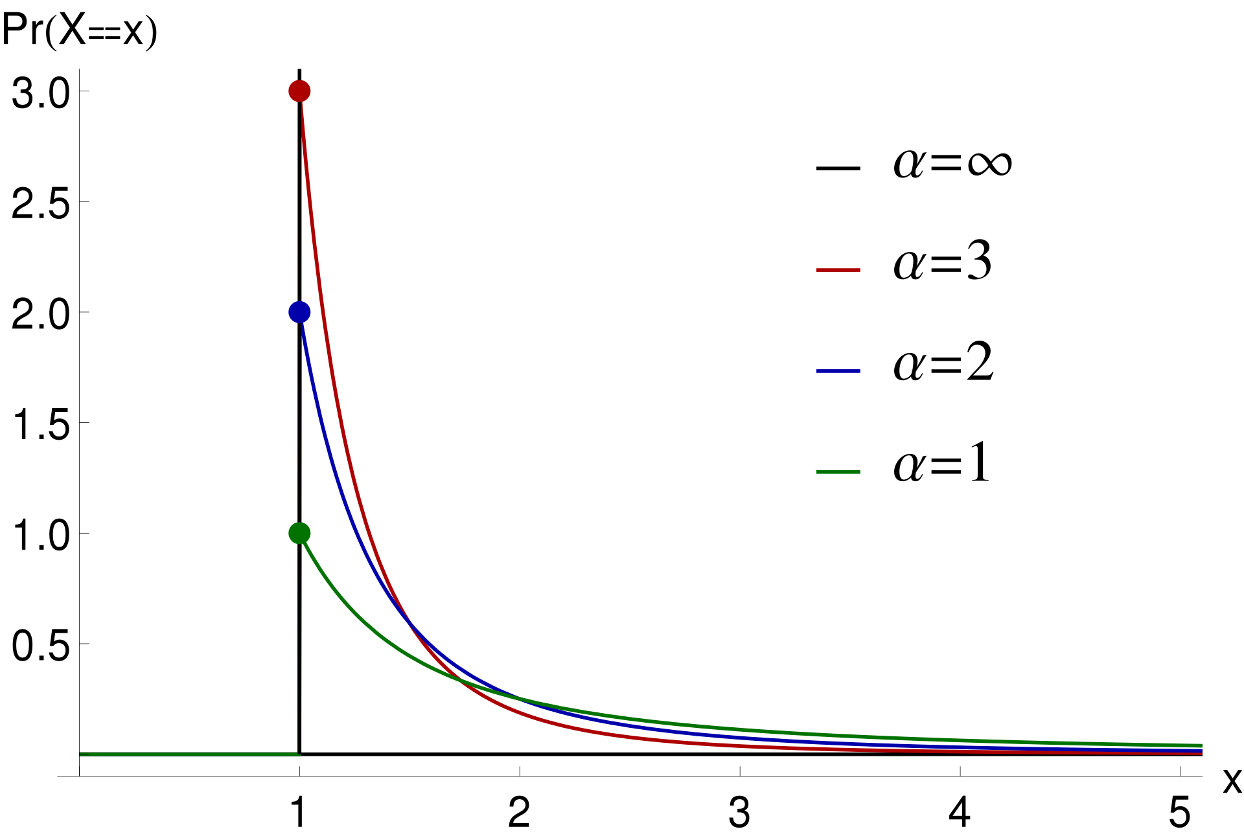
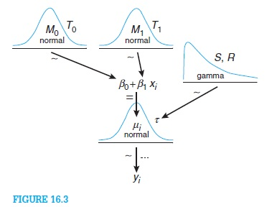
Cutpoint Options
Devanarayan et al., 2017
Pugh et al., 2014
LeBlond et al. (2022)
Traditional Approach
Extreme Value Theory
Bayesian Model
Wikipedia
Kruschke et al. 2014
Navlani, 2015, Medium
Define cutpoint based on distance from central tendencies
Mean + scalar*SD
Median + scalar*MAD
Percentiles
Define cutpoint based on the tail rather than central tendency
Fit Pareto Distribution to describe tail
Find percentiles of that distribution
Define cutpoint based on a model of the data generating process
Fit a model that describes data generation
Estimate posterior distributions
Find percentiles of posterior distributions

Slide 8
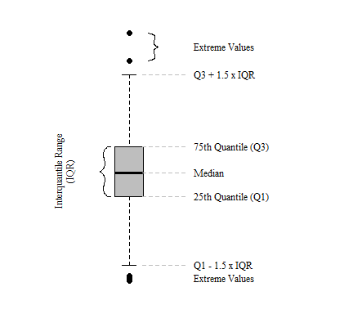
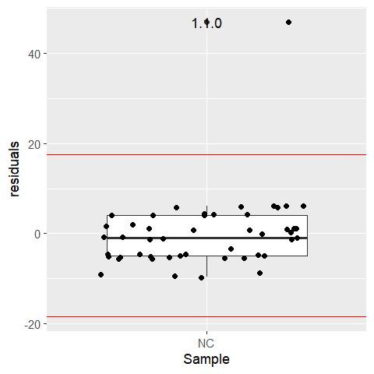
Cutpoint Analysis Workflow
1. NC Outlier Analysis
Fit the most complicated model possible to explain data; examine model
Conduct Tukey Boxplot Analysis on Residuals to Identify Outliers Replicates
Screening :
2. S/N Outlier Analysis
Confirmatory:
2. IR
Outlier Analysis
Model in R Notation
NCSignal~Run*Plate+(1|Analyst)
Simulated Data
3. S/N
Best Linear Predictor Analysis
3. IR
Best Linear Predictor Analysis
4. Determine Cutpoints
4. Determine Cutpoints
Julian, 2020
S/N is signal-to-noise ratio: NHPsample/NC
IR is inhibition ratio: 100*(1-(NHP sample + drug /,eaNHP drug free sample))

Slide 9
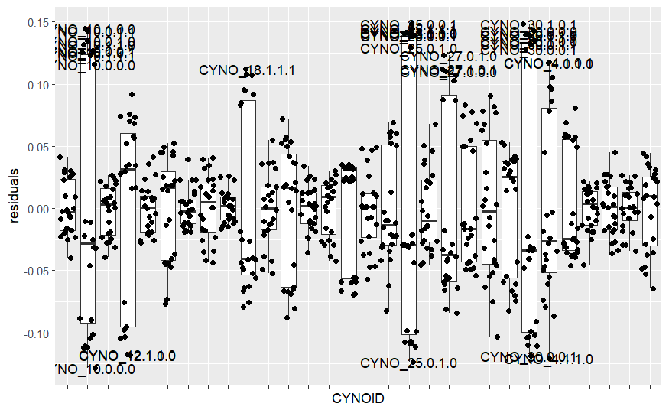
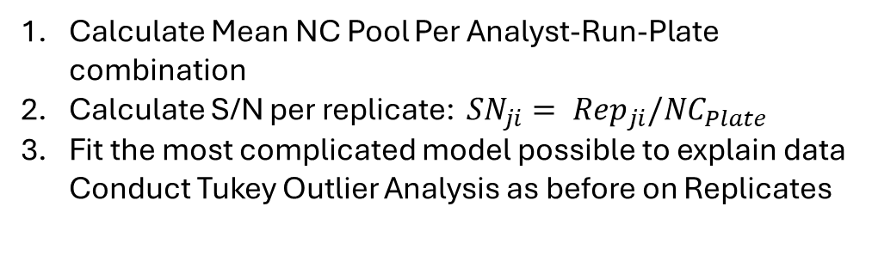
Cutpoint Analysis Workflow
Calculate Mean NC Pool Per Analyst-Run-Plate combination
Calculate S/N per replicate: ${SN}_{ji}= {Rep}_{ji}/{NC}_{Plate}$
Fit the most complicated model possible to explain data Conduct Tukey Outlier Analysis as before on Replicates
1. NC Outlier Analysis
Screening :
2. S/N Outlier Analysis
Confirmatory:
2. IR
Outlier Analysis
Model in R Notation
log10(SNratio)~Plate*Run+(1|Analyst)+(1|CYNOID)
Simulated Data
3. S/N
Best Linear Predictor Analysis
3. IR
Best Linear Predictor Analysis
4. Determine Cutpoints
4. Determine Cutpoints
S/N is signal-to-noise ratio: NHPsample/NC
IR is inhibition ratio: 100*(1-(NHP sample + drug /,eaNHP drug free sample))

Slide 10
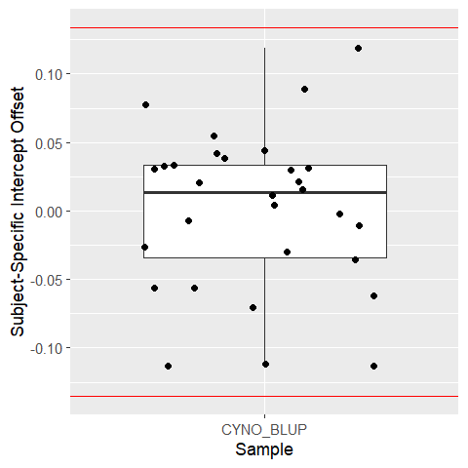
Cutpoint Analysis Workflow
1. NC Outlier Analysis
Remove outliers identified in prior step.
Re-estimate prior model and extract BLUPs BLUPs = Best Linear Unbiased Predictors; here this refers to the random-intercept estimate for each CYNO
Conduct Tukey Outlier Test with BLUPs to identify biological outliers
Screening :
2. S/N Outlier Analysis
Confirmatory:
2. IR
Outlier Analysis
Model in R Notation
log10(SNratio)~Plate*Run+(1|Analyst)+(1|CYNOID)
Simulated Data
3. S/N
Best Linear Predictor Analysis
3. IR
Best Linear Predictor Analysis
4. Determine Cutpoints
4. Determine Cutpoints
S/N is signal-to-noise ratio: NHPsample/NC
IR is inhibition ratio: 100*(1-(NHP sample + drug /,eaNHP drug free sample))

Slide 11
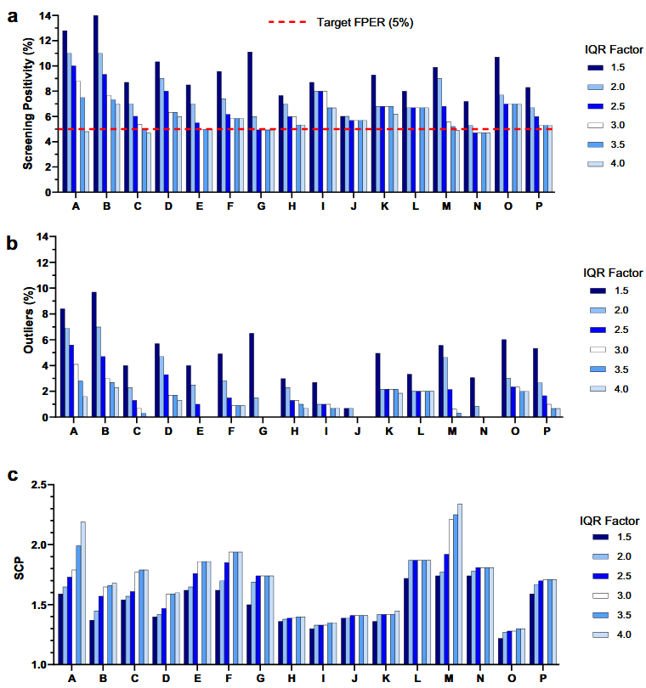
Outlier Removal May Not Be Ideal
Let’s pause here…
Inhibition ratio (IR) also starts with an outlier analysis
These outlier analyses may not be necessary, and in some cases may throw out useful information (Garlits et al., 2023)
The decision of whether to do an outlier analysis should be decided contextually.
From here I’m going to jump to determining cutpoints for S/N and IR from the frequentist perspective.
1. NC Outlier Analysis
Screening :
2. S/N Outlier Analysis
Confirmatory:
2. IR
Outlier Analysis
3. S/N
Best Linear Predictor Analysis
3. IR
Best Linear Predictor Analysis
4. Determine Cutpoints
4. Determine Cutpoints
Garlits et al. (2023)
S/N is signal-to-noise ratio: NHPsample/NC
IR is inhibition ratio: 100*(1-(NHP sample + drug /,eaNHP drug free sample))

Slide 12
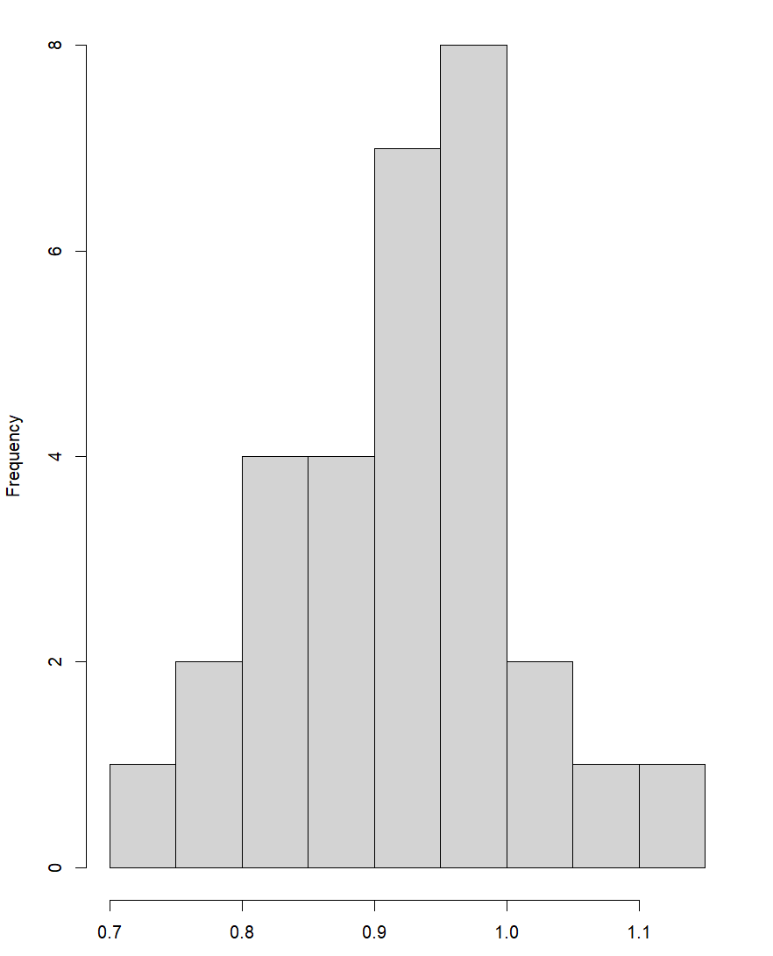
Determine Screening Cutpoints
Mean S/N calculated per CYNO and then distribution assessed
1. NC Outlier Analysis
Screening :
2. S/N Outlier Analysis
Confirmatory:
2. IR
Outlier Analysis
SCP should have a 5% FP rate with 90% confidence
3. S/N
Best Linear Predictor Analysis
3. IR
Best Linear Predictor Analysis
Log(S/N Ratio)
Yes
Normal?
No
Parametric CP
Mean + 1.645*SD
Median + 1.645*MAD
4. Determine Cutpoints
4. Determine Cutpoints
Non-Parametric
90th Percentile
S/N is signal-to-noise ratio: NHPsample/NC
IR is inhibition ratio: 100*(1-(NHP sample + drug /NHP drug free sample))

Slide 13
Determine Confirmatory Cutpoints
Mean IR calculated per CYNO and then distribution assessed
1. NC Outlier Analysis
Screening :
2. S/N Outlier Analysis
Confirmatory:
2. IR
Outlier Analysis
CCP should have a 1% FP rate with 80% confidence
3. S/N
Best Linear Predictor Analysis
3. IR
Best Linear Predictor Analysis
IR Ratio
Yes
Normal?
No
Parametric CP
Mean + 2.33*SD
Median + 2.33*MAD
4. Determine Cutpoints
4. Determine Cutpoints
Non-Parametric
99th Percentile
S/N is signal-to-noise ratio: NHPsample/NC
IR is inhibition ratio: 100*(1-(NHP sample + drug /NHP drug free sample))

Slide 14
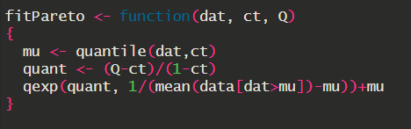
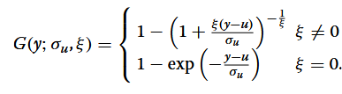
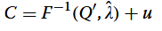
Alternative: Extreme Value Theory
Mean S/N calculated per CYNO and then distribution assessed
The parametric approach (read: normal distribution) overly relies on the center mass of the distribution when what we care about are the tails –- the extreme values. Additionally, non-parametric approaches are known to be sensitive to sample size and may in some cases be underpowered.
We may be essentially misfitting the data, leading to an misestimated cutpoint (exacerbated by outlier removal)
Pugh (2024) also raised this concern, further noting that this issue is compounded when new tests are being developed and there is little information on the prevalence or separation of positive and negative controls.
Log(S/N Ratio)
Pareto Distribution
Exponential Approximation for small Ns

Slide 15
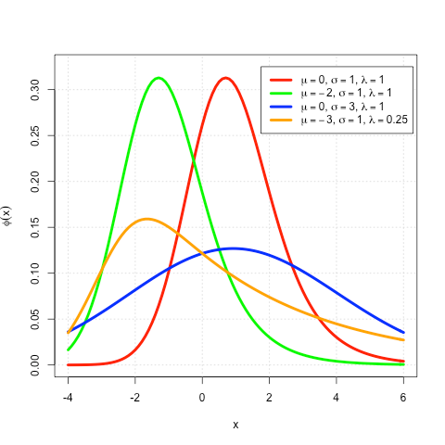


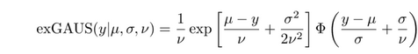
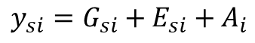
Alternative: Bayesian Estimation of exGuassian
Mean S/N calculated per CYNO and then distribution assessed
Parametric, Non-Parametric, Extreme-Value are lossy procedures because we’re relying on the mean per CYNO
LeBlond et al. (2022) argue in their book chapter “A non-normal Bayesian Model for Estimation and Comparison of Immunogenicity Screening Assay Cut Points” that an approach that uses replicate level data and models both the center mass and tails is the exGaussian distribution (originating from time-to-event studies in Psychology, Luce 1986)
Additionally, the output of a Bayesian procedure is a distribution and thus is better for at-risk decision making like determining if ADAs are present.
Log(S/N Ratio)
exGaussian (Wikipedia)
$$y_{si}=G_{si}+E_{si}+A_{i}$$
Analytical variation
$$G_{si} \sim N\left(μ,σ^{2}\right), E_{si} \sim Exp\left(υ\right), A_{i} \sim N(0,σ_{A}^{2})$$
Subject-specific variation
CP = 90th percentile of Posterior ExGaussian

Slide 16
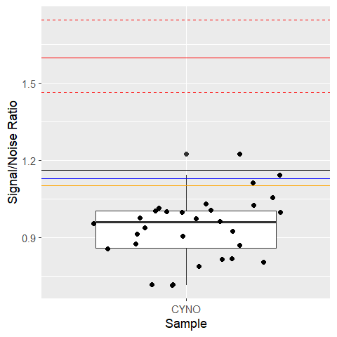
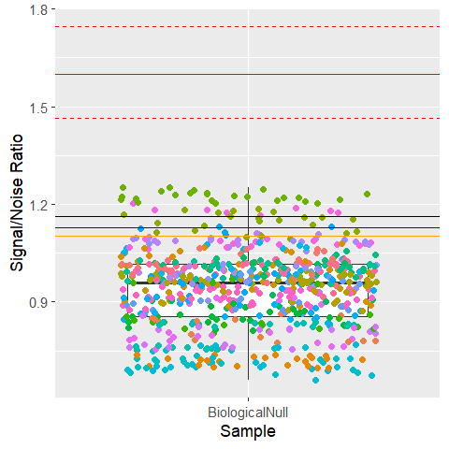
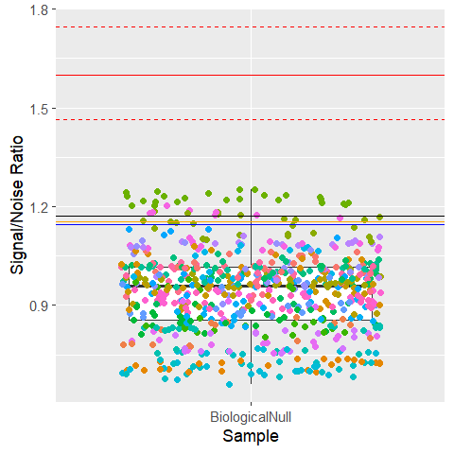
Screening Cutpoint Results
(1) Distribution of Mean CYNO S/N
with cutpoints
(2) Distribution of CYNO S/N Replicates
with cutpoints from (1)
(3) Recalculation of Non-Bayes CPs using replicates rather than means
Bayes
Mean
Pareto
Median
The Bayesian approach appropriately models the data as replicates nested within individuals affected by analytical variation. As a result, it yields the CP most removed from the central tendency of naïve individuals. Thus, values above the Bayesian CP are truly positive
Note: Calculations conducted on log scale and back transformed to the ratio for ease of interpretation

Slide 17
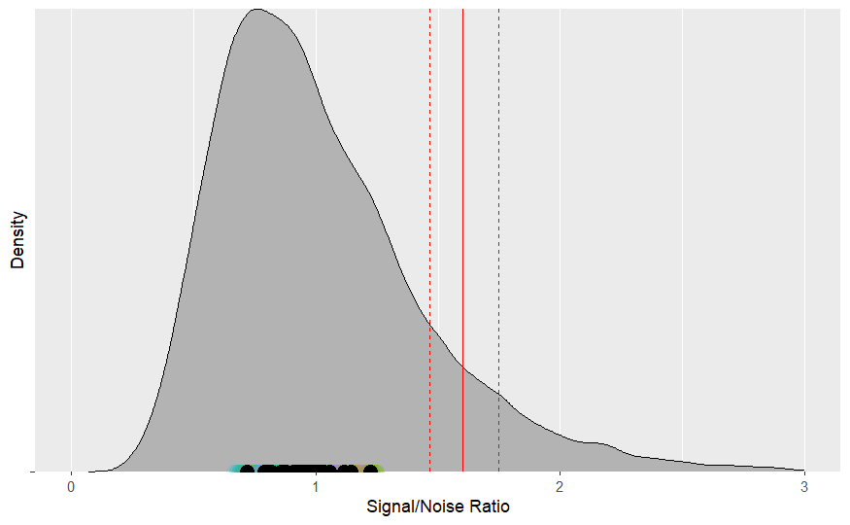
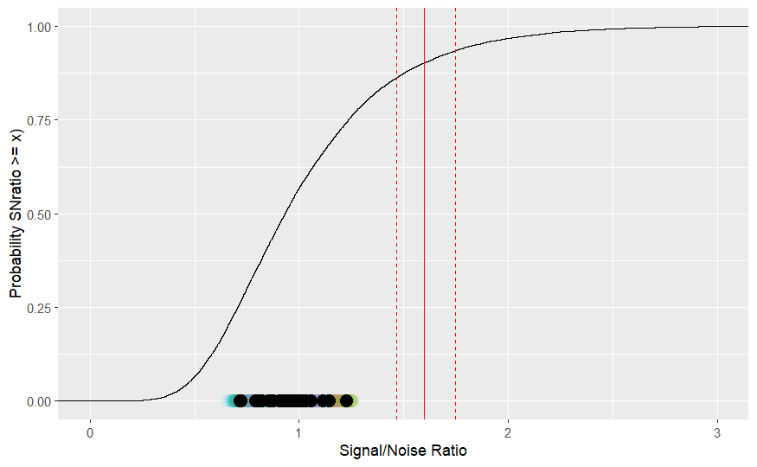
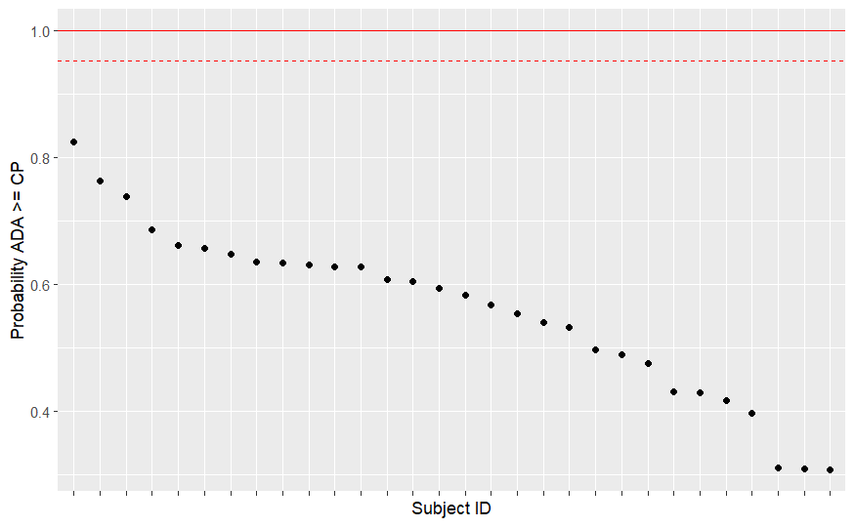
Staging Individuals By the Original Bayesian Cutpoint
Full Posterior ExGaussian Distribution
Empirical Cumulative Distribution (ECD)
Probability ADA >= CP (π)
Cutpoint with 95% HDI
Mean CP and greater
Lower HDI = 0.95
Subject
Replicates
Subject Means
π = ECD/ ECD at mean CP
if π > 1, π → 1
The ability to easily convert the posterior into an ECD is what let’s us calculate a probability of an ADA >= CP (π). As such, being able to represent individuals by π makes judging edge cases much easier.
Thus, I do recommend the Bayesian approach.

Slide 18
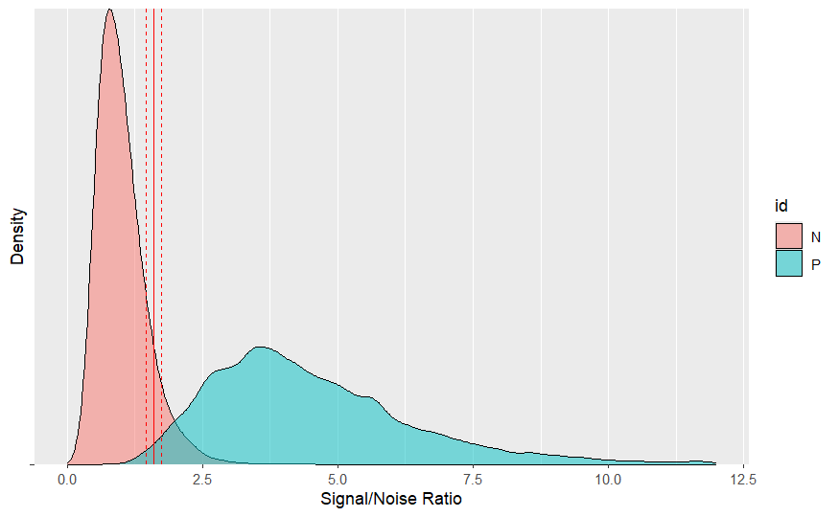
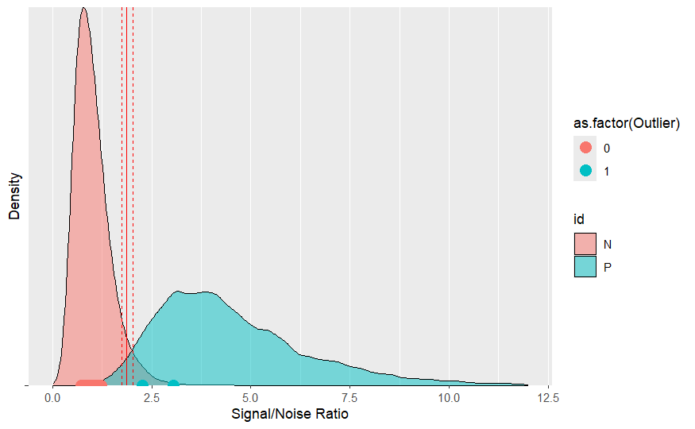
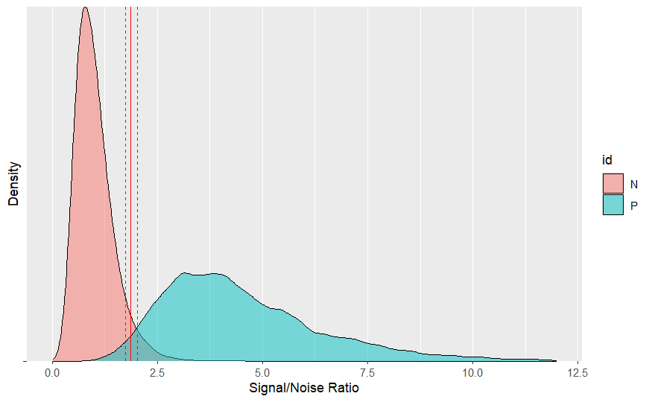
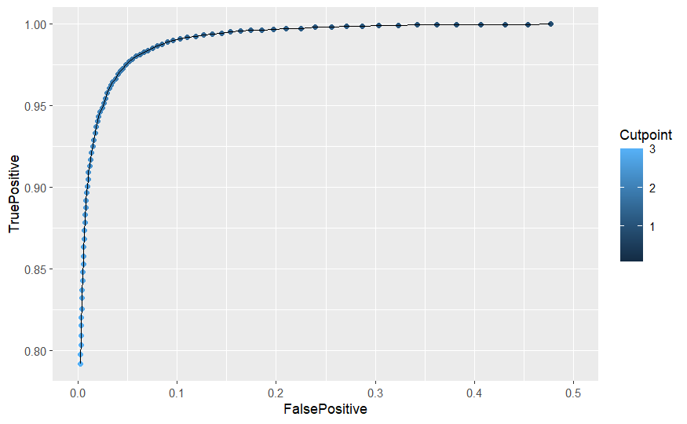


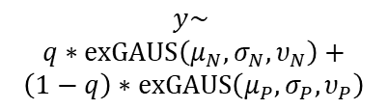
A Proposal for Capsid Antibody Cutpoints
Outlier Analysis to Identify (not remove) Potential ADA+ Subjects
Mixture distribution fit
to entire dataset*
Format and prep data for analysis
Cutpoint based on N distribution
$$y\sim$$
$$q∗exGAUS\left(μ_{N},σ_{N},υ_{N}\right)+$$
$$\left(1−q\right)∗exGAUS\left(μ_{P},σ_{P},υ_{P}\right)$$
Sensitivity Analysis to find optimal cutpoint
Implement for In-Study Use
Verify outlier location
Cutpoint based on ROC
Analysis
ΔCP = 0.275
ROC analysis
*Color coding is to show the different components of the mixture; we’re actually saying each data point has some probability (q) of coming from the naïve cohort and a complement probability (1-q) coming from the positive cohort. Also note, theoretically this mixture distribution method could be used anywhere we expect an ADAs are present prior to drug administration.

Slide 19
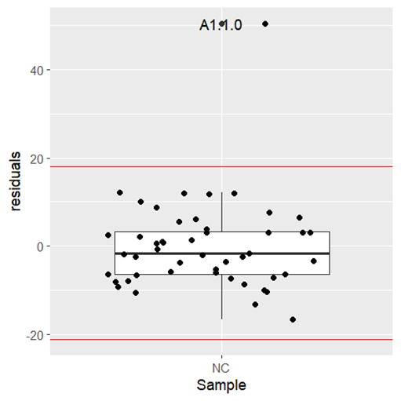

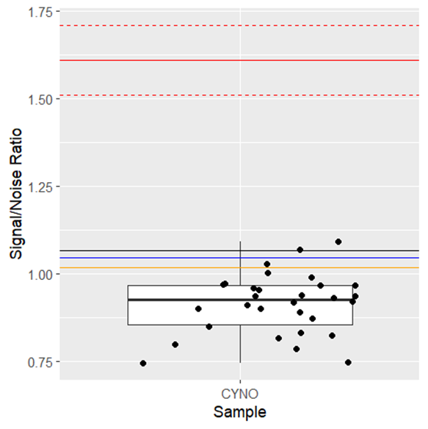
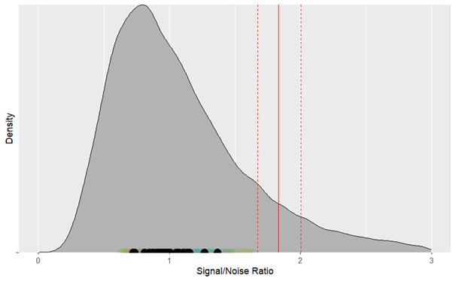
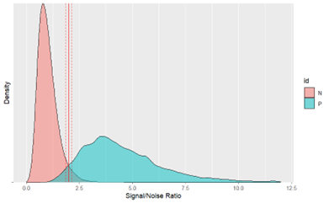
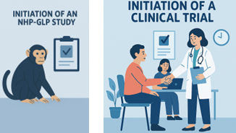

Conclusions
ADA assays for gene therapies
Collected/Simulated Data
Outlier Analysis
Defined cutpoints
Compared Cutpoint Methods
Chose & Evaluated Method
Proposed Capsid-Specific Method
Implement In-Study
Work Impact: At Lilly/Prevail we opted to use the extreme value theory method with outlier removal as a compromise between interpretability and ease of use for biologists; the method worked well in-study letting us detect transprotein ADAs
My general philosophy: Build models that encode what we know about the data generation process so that we can build principled-Bayesian models that naturally accommodate at-risk decisions by estimating uncertainty.

Slide 20
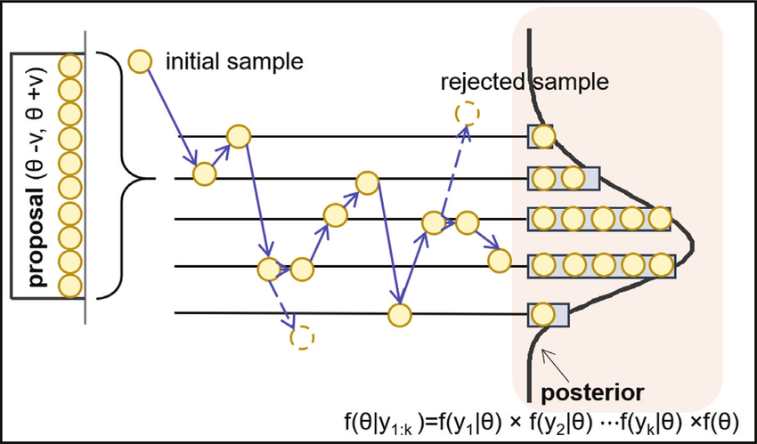
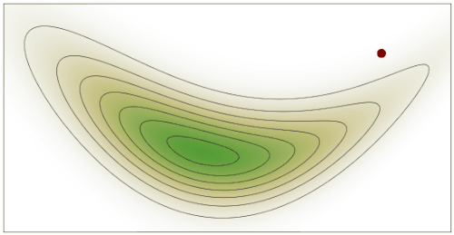
Backup Slides: Estimation of Bayesian Models
Dong et al. 2019
Wikipedia

Slide 21
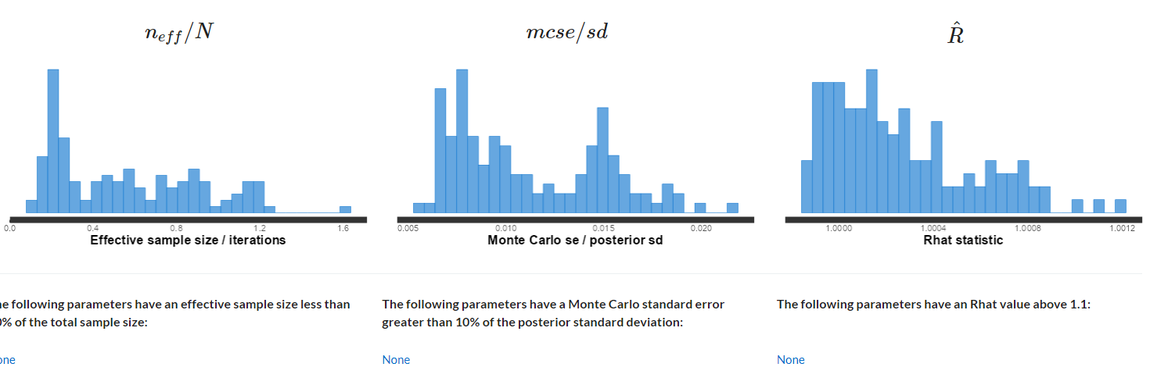
Backup Slides: Convergence of the Bayesian Model

Slide 22
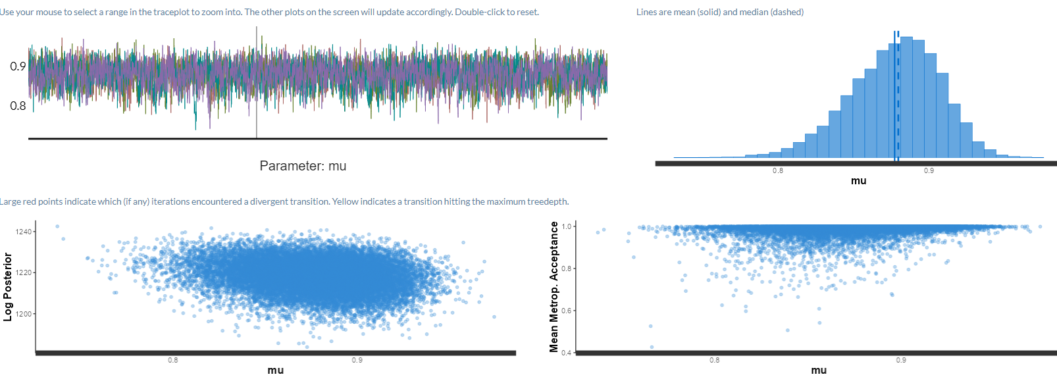
Backup Slides: Chain Mixing

Slide 23
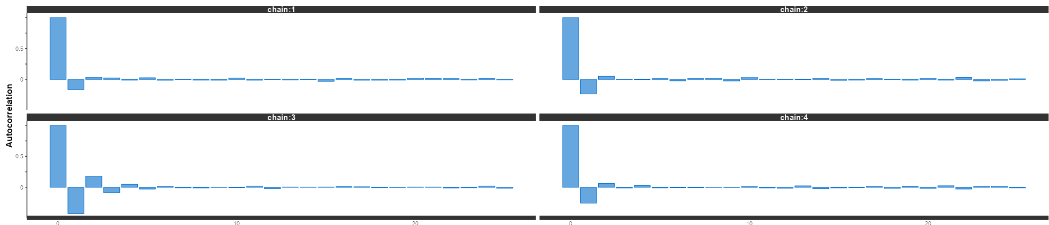
Backup Slides: Autocorrelation

